Slide 1


Identification of Thiol Function Group in Carbonaceous Chondrites which are Meteorite Analogs of Bennu
Thomas Redford^{1,2}, Robert Root³, Maitrayee Bose¹
1) Center for Isotope Analysis, School of Earth and Space Exploration, ASU. 2) Department of Physics, ASU. 3) Department of Environmental Science, University of Arizona
Space Grant Symposium 4/23/2022

Slide 2
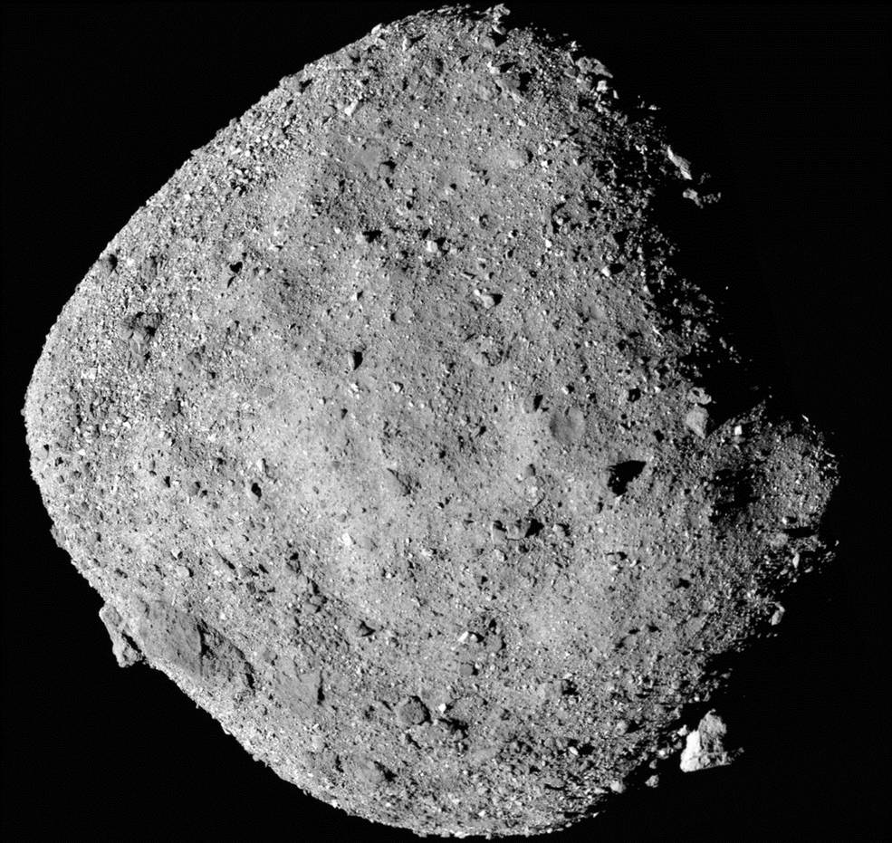
Introduction
Thiols in hydrothermal Vents on the ocean floor and are a key part of early metabolic processes. Schulte and Rogers (2004) Geochimica et Cosmochimica Acta
Fluid inclusions in 3.5-billion-year-old rock have thiols showing their early importance. Mißbach et al. (2021) Nature Communications
Carbonaceous Chondrites can serve as an analogue to 101955 Bennu. Merlin et al. (2021) Astronomy & Astrophysics
101955 Bennu
Image courtesy of NASA

Slide 3
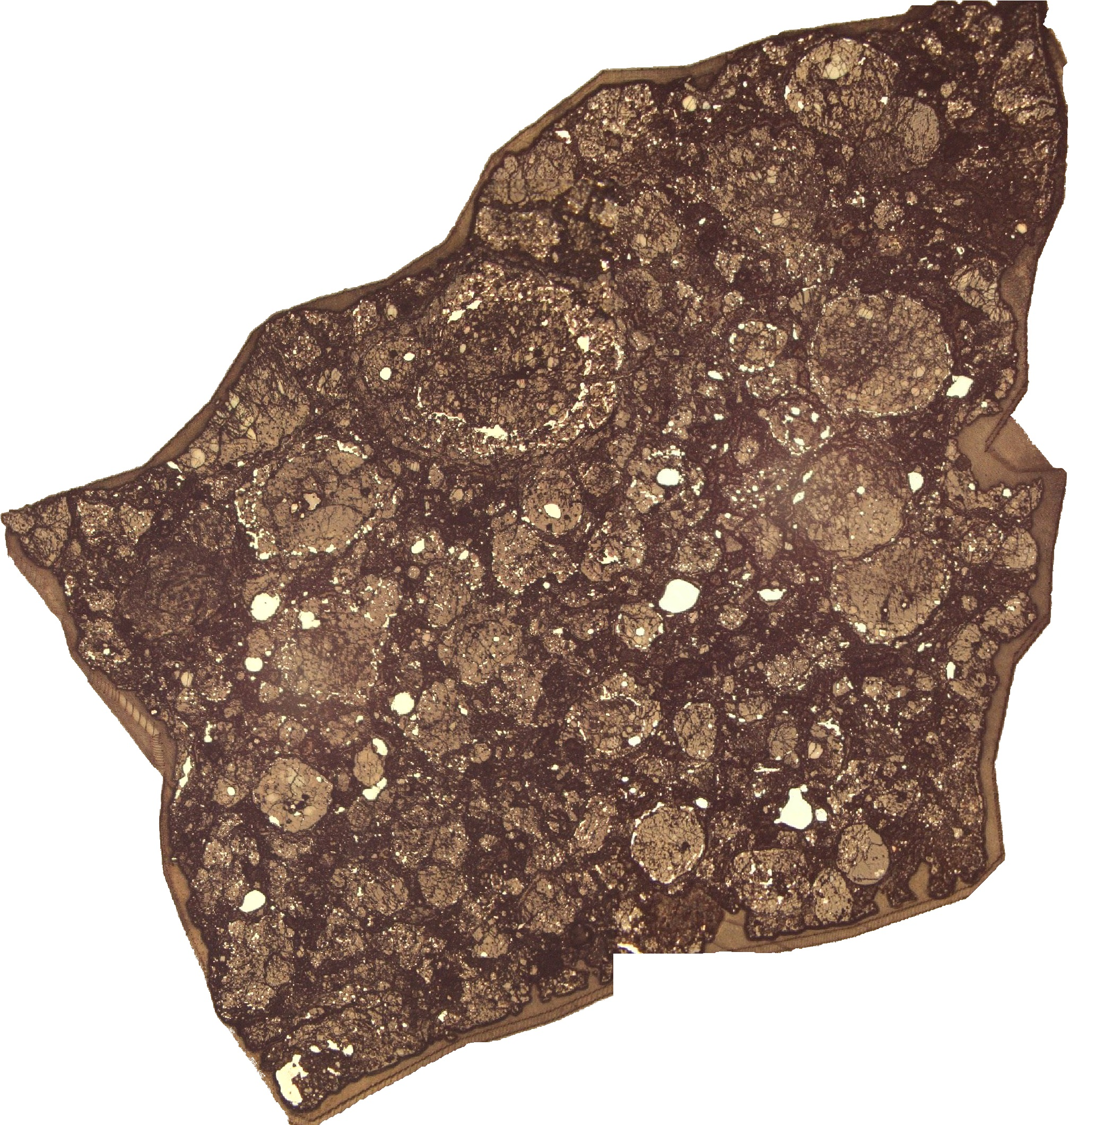
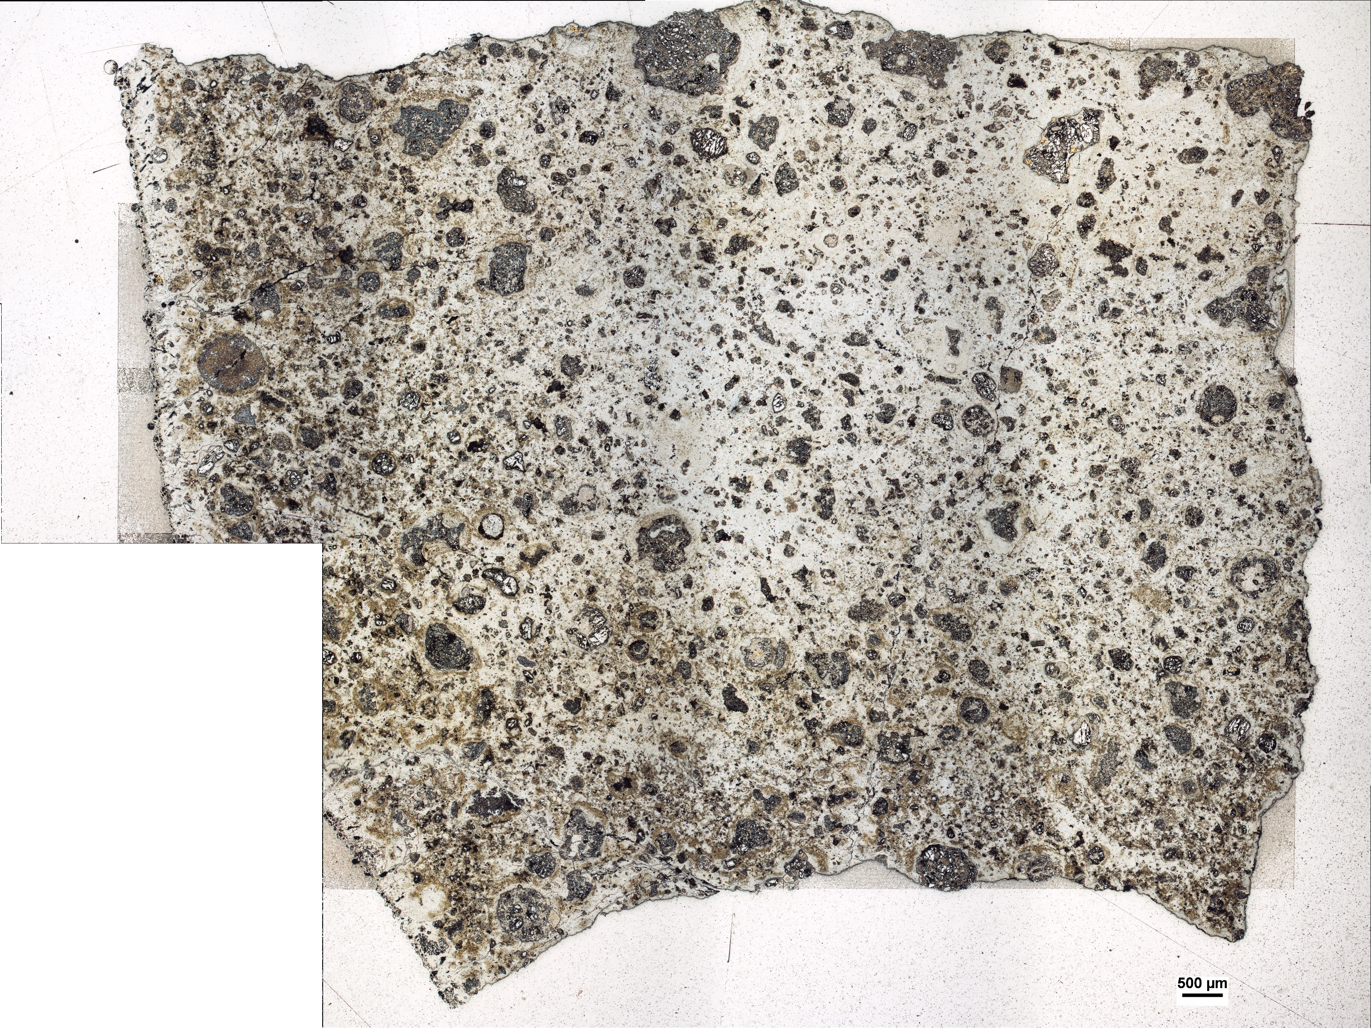
Samples
Carbon Rich CR2 Graves Nunataks 95229 (GRA 95229) and CM2 Murchison
High abundance of organic material
Limited aqueous alteration
Reflected light microscope image of GRA 95229 (left) and Murchison (right) samples

Slide 4
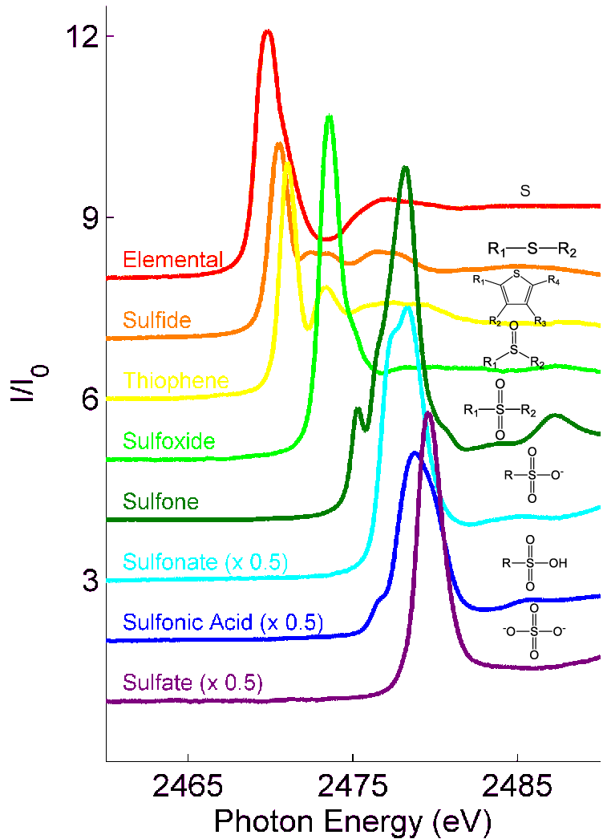
X-Ray Spectroscopy
Nondestructive, high resolution (3 – 5 µm), and in situ
X-Ray Absorption Near Edge Structure (XANES) – Full spectra for small areas
Micro X-Ray Fluorescence (µXRF) – Elemental maps of larger areas
Image source: Abdallah et al. (2017) SPE Middle East Oil & Gas Show and Conference

Slide 5
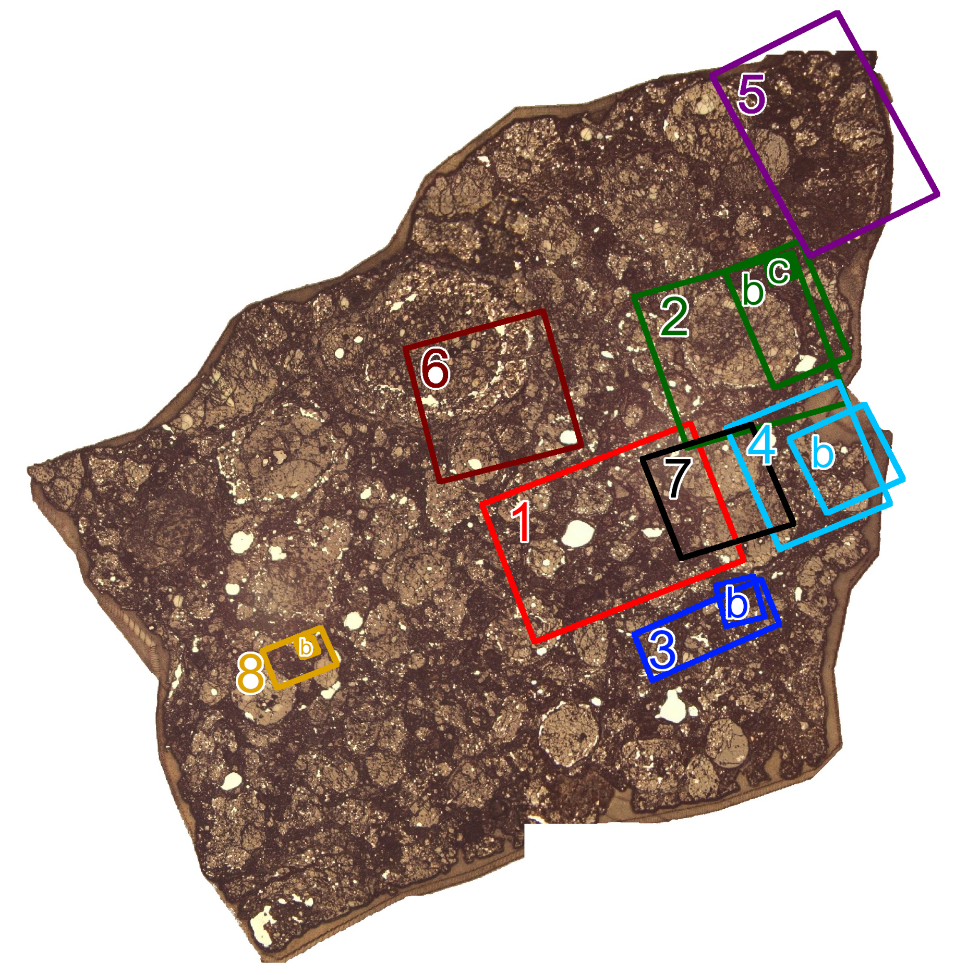
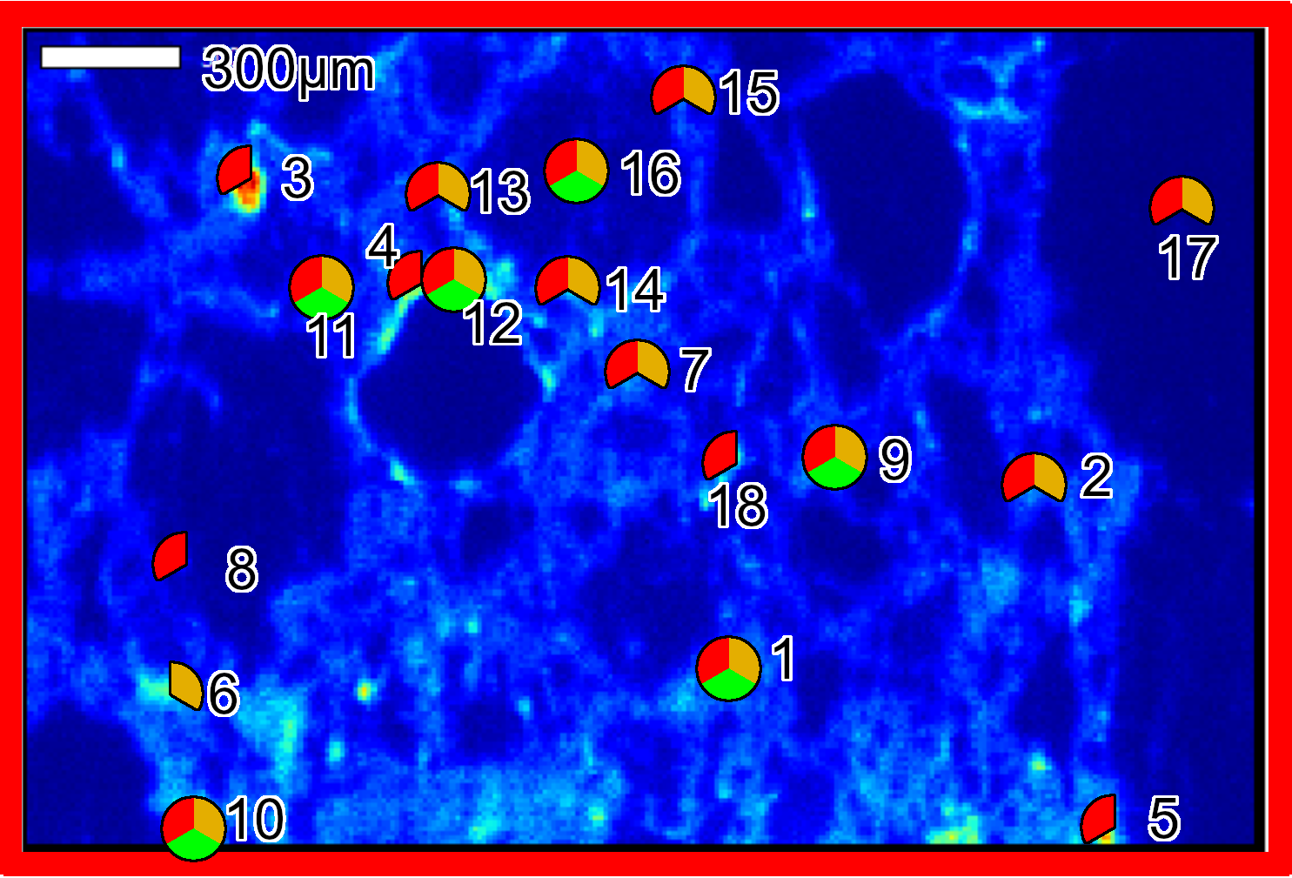

Results
For the first time, thiol and elemental sulfur have been found in situ on these two meteorites

Slide 6
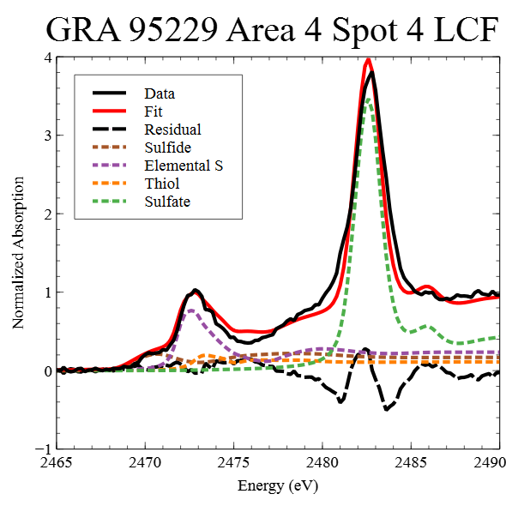
Fitting
Linear Combination Fitting
Used four sulfur standards: Sulfide, Elemental Sulfur, Thiol, and Sulfate
Reduced chi-square: χ² = 0.0197

Slide 7
Implications/Future Work
We will conduct mineralogy and thermodynamic modeling of the meteorite and the formation of organics
Isotopic Analysis of organics (Using NanoSIMS)
Better prepared for studying samples from Bennu

